Slide 1
COMP 51 Week Seven
Functions and Scope

Slide 2
Learning Objectives
Functions
What are they?
How do they work?
Where to use them
Scope Rules
Variable definition and location

Slide 3
Why Do We Care
Another basic programming building block
Repeatability
Modularity – Code Sharing
Code is easier to read!

Slide 4
Introduction to Functions
Building Blocks of Programs
Other terminology in other languages:
Procedures, subprograms, methods
In C++: functions
I-P-O
Input – Process – Output
Basic subparts to any program
Use functions for these "pieces"
#include <iostream>
Main () {
a();
}
Function a
Function b
Function c
Notes:
Comment function declaration:
void showInterest(double balance, double rate); //Precondition: balance is nonnegative account balance // rate is interest rate as percentage //Postcondition: amount of interest on given balance, // at given rate …

Slide 5
Getting Abstract
Need to know "what" function does, not "how" it does it!
Think "black box"
Device you know how to use, but not it’s method of operation
Implement functions like black box
User of function needs to know what input to send to function
Then needs to know what output to receive

Slide 6
Predefined Functions
Libraries full of functions for our use!
Must "#include" appropriate library
<cmath>, <cstdlib> (Original "C" libraries)
<iostream> (for cout, cin)
Example: theRoot = sqrt(9.0);
Input parameters between parens
Output result is assigned to variable
Name which identifies the Process
Notes:
The expression "sqrt(9.0)" is known as a function call, or function invocation
The argument in a function call (9.0) can be a literal, a variable, or an expression
The call itself can be part of an expression:
bonus = sqrt(sales)/10;
A function call is allowed wherever it’s legal to use an expression of the function’s return type

Slide 7
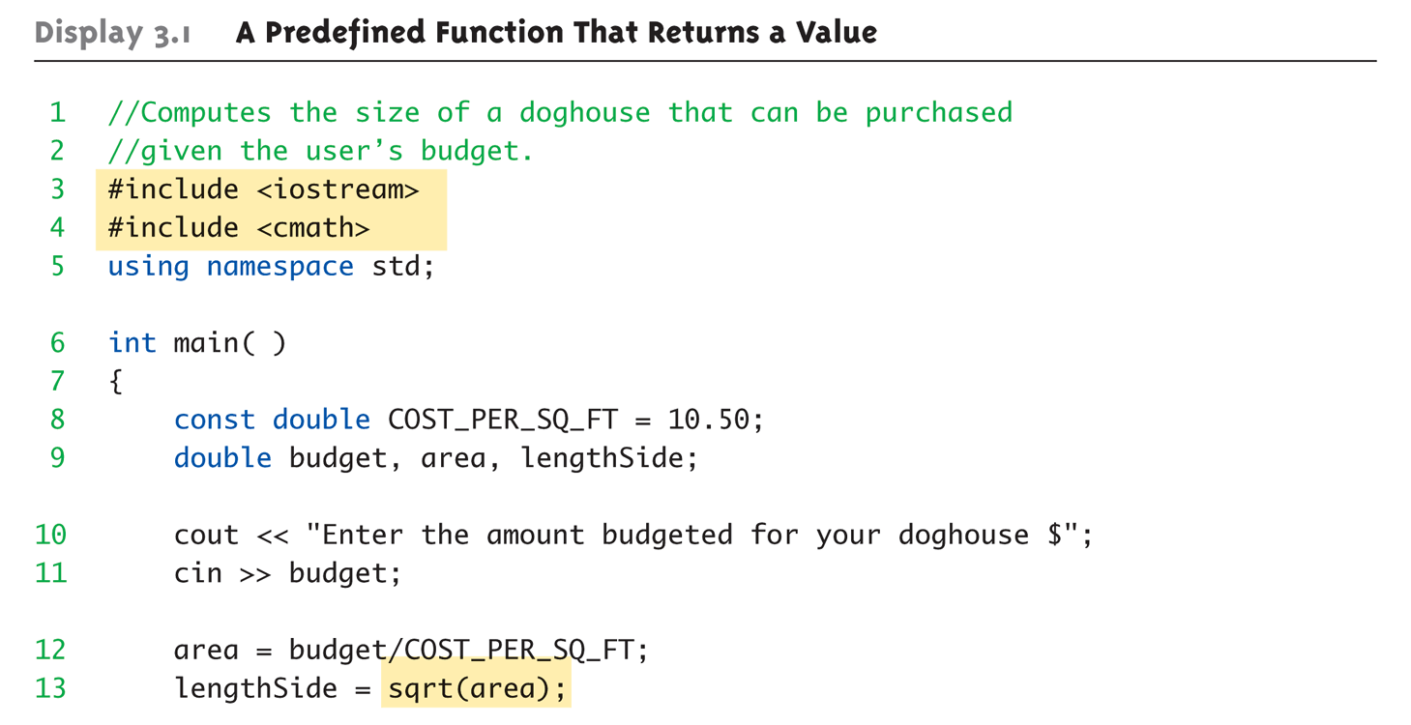
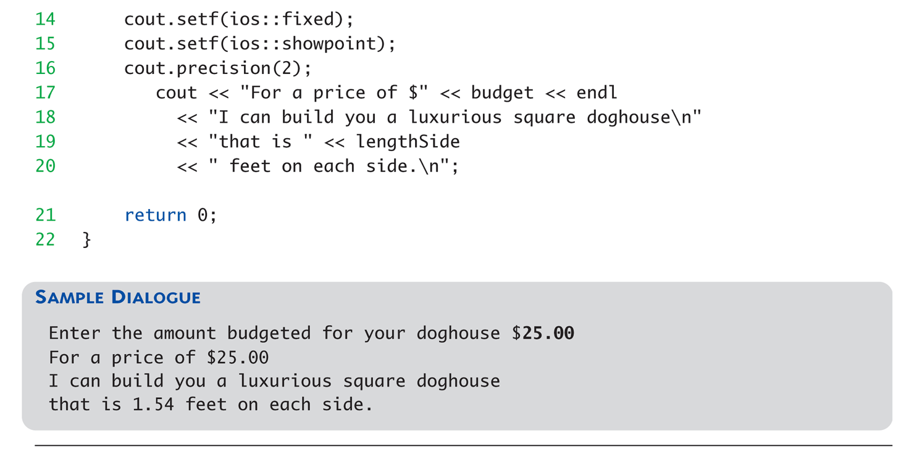
Square Root in Action

Slide 8
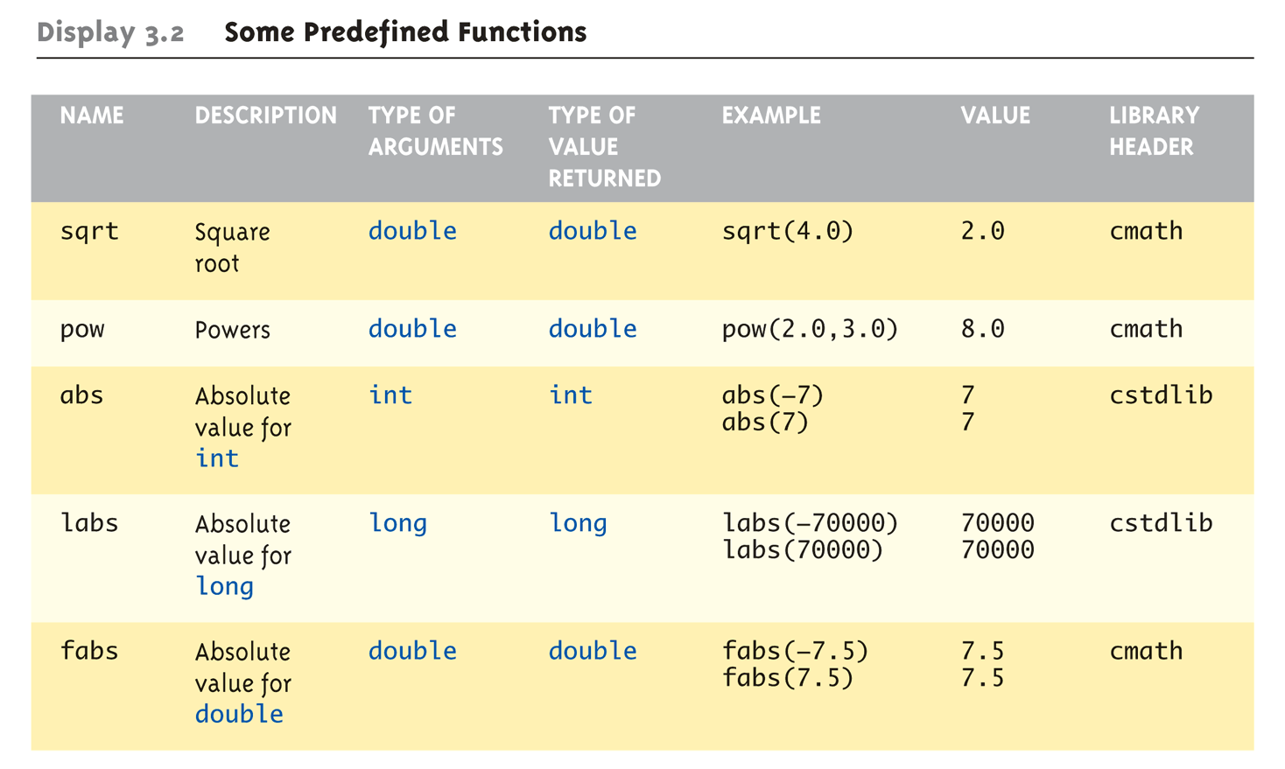
Even More Math Functions: Display 3.2 Some Predefined Functions (1 of 2)
Notes:
Can be confusing
Remember: libraries were added after C++ was "born," in incremental phases
Refer to appendices/manuals for details

Slide 9
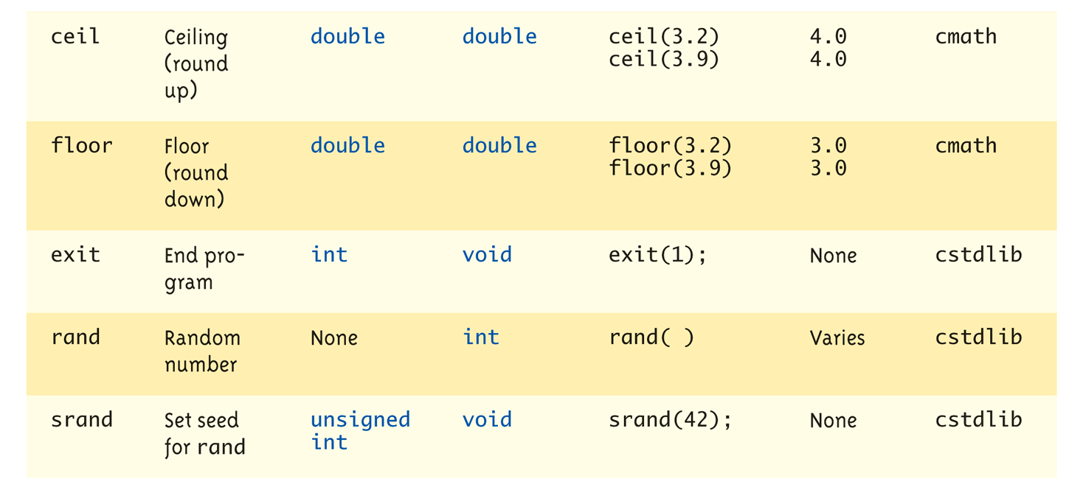
Even More Math Functions: Display 3.2 Some Predefined Functions (2 of 2)

Slide 10
Math Function Practice
Write the function call for this math expression
X = | (-4)³ |
What should the answer be?

Slide 11
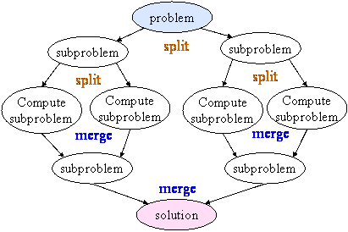
Programmer-Defined Functions
Write your own functions!
Building blocks of programs
Divide & Conquer
Readability
Re-use

Slide 12
Generic Program Layout
#include // header files
// Global Declaration area variables int sum(int a, int b);
// function prototypes
int main () {
int total = sum(2,2); //function call
} // primary program & first called
int sum(int a, int b) {
//function definition
int c = a + b;
Return(c);
}
// More user defined functions
Notes:
Function prototype or declaration tells the compiler what the function is all about.
3 Pieces to using functions:
Function Declaration/prototype
Information for compiler
To properly interpret calls
Function Definition
Actual implementation/code for what function does
Function Call
Transfer control to function

Slide 13
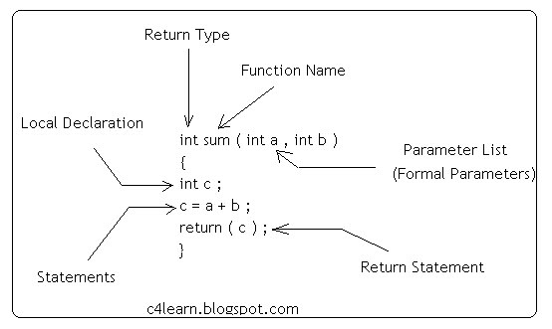
Function Definition Details
Notes:
Placed after function main()
NOT "inside" function main()!
Functions are "equals"; no function is ever "part" of another
Formal parameters in definition
"Placeholders" for data sent in
"Variable name" used to refer to data in definition
return statement
Sends data back to caller

Slide 14
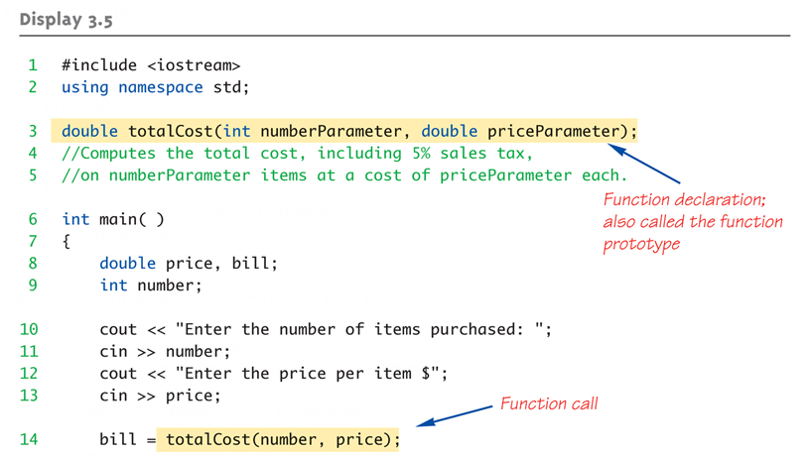
Function Example: Display 3.5 A Function to Calculate Total Cost (1 of 2)
Notes:
Just like calling predefined function bill = totalCost(number, price);
Recall: totalCost returns double value
Assigned to variable named "bill"
Arguments here: number, price
Recall arguments can be literals, variables, expressions, or combination
In function call, arguments often called "actual arguments"
Because they contain the "actual data" being sent

Slide 15
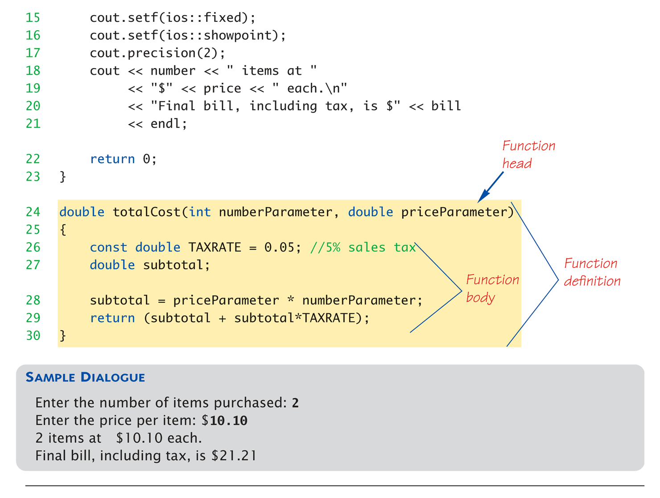
Function Example: Display 3.5 A Function to Calculate Total Cost (1 of 2)

Slide 16
Function Practice
Write a function to calculate the Factorial value.
Receives an integer input
Returns an integer result
Hint – see slides COMP 51-04 for loop details

Slide 17
Alternative Function Declaration
Recall: Function declaration is "information" for compiler
Compiler only needs to know:
Return type
Function name
Parameter list
Formal parameter names not needed: double totalCost(int, double);
Still "should" put in formal parameter names
Improves readability

Slide 18
Parameter vs. Argument
Terms often used interchangeably
Formal parameters/arguments
In function declaration
In function definition’s header
Actual parameters/arguments
In function call
Technically parameter is "formal" piece while argument is "actual" piece*
*Terms not always used this way

Slide 19
Arguments vs Parameters
int main () {
int x = 2, y = 2;
int total = sum(x,y); //function call
}
Function call actual arguments
Function formal parameters
int sum(int a, int b) {
//function definition
int c = a + b;
Return(c);
}
// More user defined functions

Slide 20
Functions Calling Functions
We’re already doing this!
main() IS a function!
Only requirement:
Function’s declaration must appear first
Function’s definition typically elsewhere
After main()’s definition
Or in separate file
Common for functions to call many other functions
Function can even call itself → "Recursion“
Think movie “Inception”

Slide 21
Boolean Return-Type Example
#include <iostream>
bool validRate(int rate) ; // what is this ???
int main () {
int enteredRate = 0;
cout << “Enter interest Rate”;
cin >> enteredRate
if (validRate(enteredRate)) //function call cout << "Rate is valid\n";
}
bool validRate(int rate)
{ return (((rate>=10)&&(rate<20))||(rate==0); }

Slide 22
Boolean Function Practice
Write a function that plays heads and tails
Receives string input (“Heads”, “Tails”)
Randomly generate a number between 1 → 100
Return true if the number is even and input is Heads
Return true if the number is odd and input is Tails
Otherwise return false

Slide 23
Exception to I-P-O
Void functions
Do not return any value
So technically there is only input and processing
What good is it?
Exiting a program with a error value
exit(1); // No return value, so not assigned. Terminates program
Process Data and Show Results

Slide 24
Entering the Void
#include <iostream>
Void showResults(double fDegrees, double cDegrees);
And no assignment statement
int main () {
showResults(32.5, 0.3);
}
void showResults(double fDegrees, double cDegrees) { cout.setf(ios::fixed); cout.setf(ios::showpoint); cout.precision(1); cout << fDegrees<< " degrees fahrenheit equals \n" << cDegrees << " degrees celsius.\n"; }
Note – There is no return statement

Slide 25
main() is "Special"
main() IS a function
"Special" in that:
One and only one function called main() will exist in a program
Who calls main()?
Operating system
Tradition holds it should have return statement
Value returned to "caller" → Here: operating system
Should return "int" or "void"

Slide 26
Last Word on Return Statements
Transfers control back to "calling" function
For return type other than void, MUST have return statement
Typically the LAST statement in function definition ➔ GOOD programming practice
return statement optional for void functions
Closing } would implicitly return control from void function

Slide 27
Learning Objectives
Functions
What are they?
How do they work?
Where to use them
Scope Rules
Variable definition and location

Slide 28
Scoping Things Out
Global scope
#include <iostream>
// function declarations
const int MAX = 100;
int main () {
string temp;
int result = 0;
function1(temp);
result = function2(5, 10.5);
}
Void function1 (string input) {
int i = 0;
// some calculations
}
Local parameter and variable
int function2 (int p1, float p2) {
int i = 0;
// some calculations
return(i);
}
Different variable i
Notes:
Local variables
Declared inside body of given function
Available only within that function
Can have variables with same names declared in different functions
Scope is local: "that function is it’s scope"
Local variables preferred
Maintain individual control over data
Need to know basis
Functions should declare whatever local data needed to "do their job"

Slide 29
Global Constants and Global Variables
Declared "outside" function body
Global to all functions in that file
Declared "inside" function body
Local to that function
Global declarations typical for constants:
const double TAXRATE = 0.05;
Declare globally so all functions have scope
Global variables?
Possible, but SELDOM-USED
Dangerous: no control over usage!

Slide 30
Scoping Blocks
Declare data inside compound statement { … }
Called a "block"
Has "block-scope"
Note: all function definitions are blocks!
This provides local "function-scope"
Loop blocks: for (int ctr=0;ctr<10;ctr++) { sum+=ctr; }
Variable ctr has scope in loop body block only

Slide 31
Nested Scope
Same name variables declared in multiple blocks
Very legal; scope is "block-scope"
No ambiguity
Each name is distinct within its scope
But confusing as H***!
Which “i” does the code refer to?

Slide 32
Scope and Parameters
Within a function, the parameters become local variables
Therefore, parameters can be modified
What happens to the arguments?
Example
int sumRange(int from, int to) {
int sum = from;
While (from < to) sum += from++;
Return(sum);
}

Slide 33
Pass/Call by Value
This constant numbers are passed as values to function
Example
Int firstSum = sumRange(5, 10);
Int b = sumRange(firstSum,40);
The variable firstSum has copy of value passed to function

Slide 34
Changing an Input Variable
Issue – How many return values can a function have?
What if we want to change the parameters?
Technique called “pass by reference”
Memory Location
Variable Definition
Function Parameter

Slide 35
Pass by Reference Parameters
Only difference is to use the ‘&’ symbol
Example
void mySquare(int &num) { // type check & pass by reference
num = num*num; // square num back in its place
}
calcVal = 4;
mySquare(calcVal); // just a normal call, the compiler knows to pass a reference

Slide 36
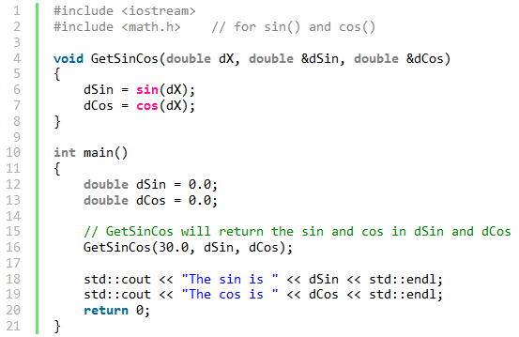
Multiple Parameters 1 Input, 2 Output
dX is input only
dSin and dCos are output parameters
Must use variables (not constants) as arguments

Slide 37
Pass by Reference Practice
Prompt the user to enter their name
Save name in a string variable
Write a void function that accepts a string variable by reference.
The function should insert “Hello” at the beginning of the input string
Print the result in main.

Slide 38
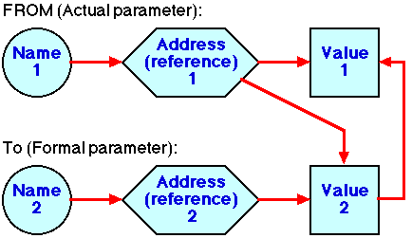
Pass by Reference Summary

Slide 39
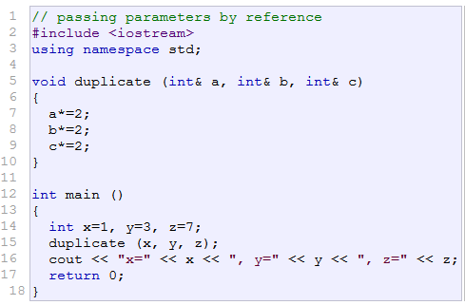

One More Example

Slide 40
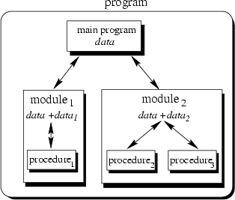
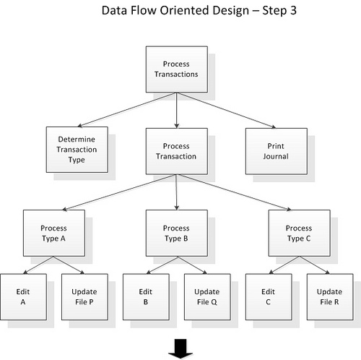
Modular Programming Concepts

Slide 41
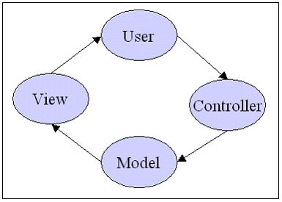
Most Famous Example Model-View-Controller

Slide 42
Key Takeaways
A function that doesn’t return something is __________
Otherwise, functions need to have a ________ statement
Functions should be "black boxes"
Hide "how" details
Declare own local data
Keep variable in _________ perspective?
Local vs global

